Slide 1

ANALYZING THE IMPACT OF CAR FEATURES ON PRICE AND PROFITABILITY
BY- ALANKRITA PAUL

Slide 2
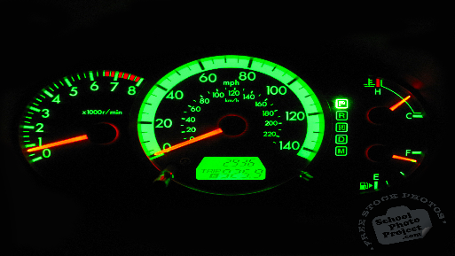
TABLE OF CONTENTS
PROJECT DESCRIPTION
TASK: ANALYSIS
TASK: DASHBOARD
TECH-STACK USED
APPROACH
INSIGHTS AND RESULTS
CONCLUSION
DRIVE LINK

Slide 3
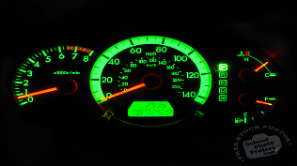
PROJECT DESCRIPTION
The automotive industry has been growing at a rapid pace, and the focus has been on developing more fuel-efficient, environmentally sustainable, and technologically advanced vehicles. With the increase in competition and change in consumer preferences, it has become crucial to understand the factors that drive car demand. Electric and hybrid vehicles are gaining popularity, and alternative fuel sources like hydrogen and natural gas are also becoming more popular. Gasoline-powered cars are still the most dominant, with varying fuel types and grades available. To make better decisions regarding pricing and product development, car manufacturers can analyze the relationship between features, market categories, and pricing, identifying popular and profitable categories.
Data analysis techniques, such as regression analysis and market segmentation, can help manufacturers develop a pricing strategy that balances consumer demand with profitability. This approach can enhance competitiveness and profitability over time while focusing on product features for future development.

Slide 4

The names of the columns used are:
Make: the make or brand of the car
Model: the specific model of the car
Year: the year the car was released
Engine Fuel Type: the type of fuel used by the car (gasoline, diesel, etc.)
Engine HP: the horsepower of the car's engine
Engine Cylinders: the number of cylinders in the car's engine
Transmission Type: the type of transmission (automatic or manual)
Driven_Wheels: the type of wheels driven by the car (front, rear, all)
Number of Doors: the number of doors the car has
Market Category: the market category the car belongs to (Luxury, Performance, etc.)
Vehicle Size: the size of the car
Vehicle Style: the style of the car (Sedan, Coupe, etc.)
Highway MPG: the estimated miles per gallon the car gets on the highway
City MPG: the estimated miles per gallon the car gets in the city
Popularity: a ranking of the popularity of the car (based on the number of times it has been viewed on Edmunds.com)
MSRP: the manufacturer's suggested retail price of the car

Slide 5

TASK: ANALYSIS
A_Task- 1: How does the popularity of a car model vary across different market categories?
A_Task- 2: What is the relationship between a car's engine power and its price?
A_Task- 3: Which car features are most important in determining a car's price?
A_Task- 4: How does the average price of a car vary across different manufacturers?
A_Task- 5: What is the relationship between fuel efficiency and the number of cylinders in a car’s engine?

Slide 6

TASK: DASHBOARD
D_Task- 1: How does the distribution of car prices vary by brand and body style?
D_Task- 2: Which car brands have the highest and lowest average MSRPs, and how does this vary by body style?
D_Task- 3: How do the different features such as transmission type affect the MSRP, and how does this vary by body style?
D_Task- 4: How does the fuel efficiency of cars vary across different body styles and model years?
D_Task- 5: How does the car's horsepower, MPG, and price vary across different Brands?

Slide 7





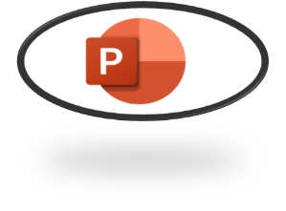

TECH-STACK USED
MICROSOFT EXCEL: FOR DATA CLEANING, ANALYZING ETC
TABLEAU: FOR CREATING DASHBOARD
MICROSOFT POWERPOINT: FOR CREATING THE REPORT

Slide 8

APPROACH
1. Data Collection and Familiarization
2. Data Cleaning and Preparation
3. Data Analysis
4. Building the Interactive Dashboard
5. Project Report

Slide 9

1. Data Collection and Familiarization:
The project started with downloading the provided dataset.
Then I started by thoroughly reading the provided project details to gain a comprehensive understanding of the objectives and requirements.
2. Data Cleaning and Preparation:
The dataset underwent the data cleaning process in Excel.
The data types were changed, missing values were handled, and other formatting was done to ensure ease of analysis.
3. Data Analysis:
• The process started with analyzing the dataset to uncover insights regarding the impact of car features on price and profitability.
• Pivot tables were created to summarize and aggregate the data, enabling a better understanding of the relationships between different variables.
• Regression analysis was performed to identify the variables with the strongest relationship to a car’s price.
• Graphical visualizations, such as bar charts, scatter plots, line charts, and bubble charts, were used to present the findings.

Slide 10

4. Building the Interactive Dashboard:
• Tableau was used to create an interactive dashboard that would allow us to explore the data and derive insights.
• Filters and slicers were added to the dashboard to make it interactive.
• Visualizations such as stacked column charts, scatter plots, and line charts, were used to provide an informative dashboard.
5. Project Report:
• A project report was made after completing the data analysis and
dashboard.
• This report was made using PowerPoint and it consists of the detailed
explanation for the project.

Slide 11

INSIGHTS AND RESULTS

Slide 12
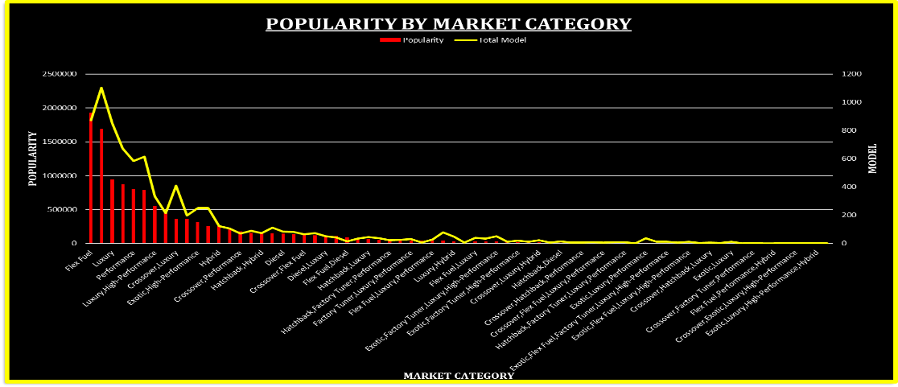

A_Task- 1: How does the popularity of a car model vary across different market categories?

Slide 13

A_Task- 1: How does the popularity of a car model vary across different market categories?
The market category “Flex Fuel” has the highest popularity with a total of 19,33,488 models. It is closely followed by the market category “Crossover” with a popularity of 16,86,521.
Although the market category “Flex Fuel” has the highest popularity than “Crossover”, the models present in the market for “Crossover” is more than “Flex Fuel”.
The market category “luxury”, “luxury performance”, and “performance” have relatively lower popularity, but they have a significant number of models present in the market.

Slide 14
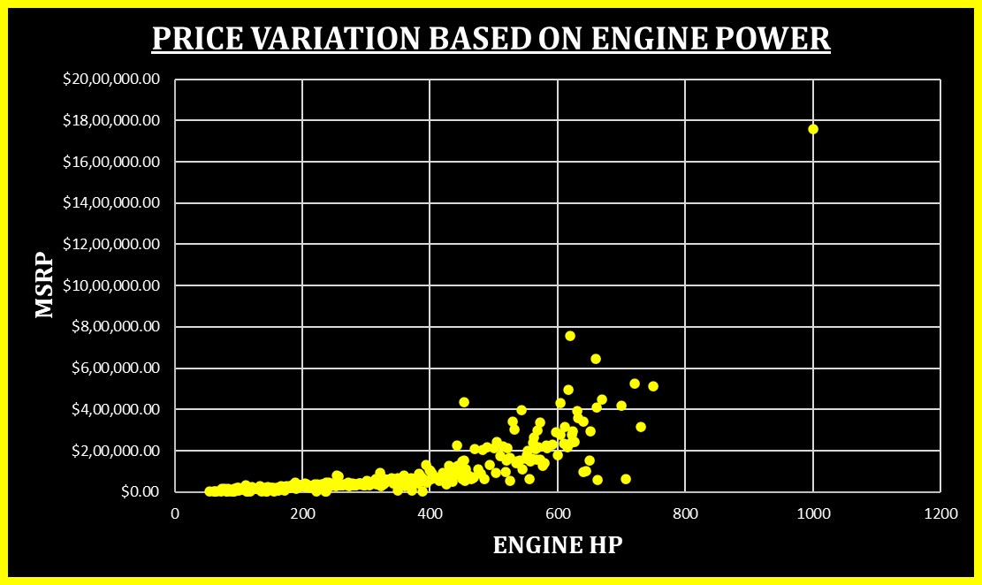

A_Task- 2: What is the relationship between a car's engine power and its price?

Slide 15

A_Task- 2: What is the relationship between a car's engine power and its price?
There is a clear relationship between Engine HP and car prices. As the Engine HP increases, the average cost of the car also increases.
For example, cars with an Engine HP of 55 have an average cost of $2,000, while cars with an Engine HP of 1001 have an average cost of $17,57,223.67.

Slide 16
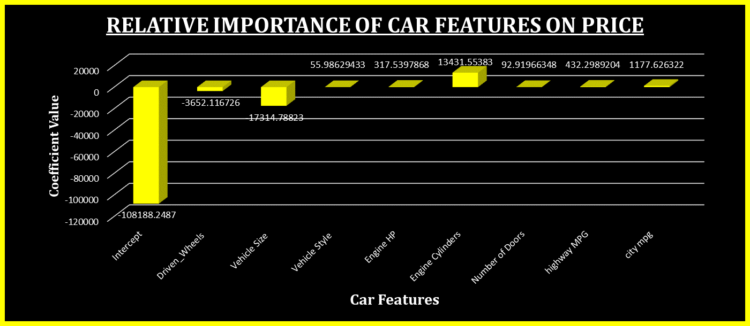
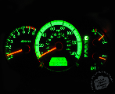
A_Task- 3: Which car features are most important in determining a car's price?

Slide 17


According to the regression analysis, the car feature that has the least importance on the price of the vehicle is “intercept”. On the other hand, the “engine cylinder” has the highest importance.
Other features that show relative importance in determining the price of a car include “City MPG”, “Highway MPG”, “engine HP”, “vehicle style”, and “Number of doors”.

Slide 18
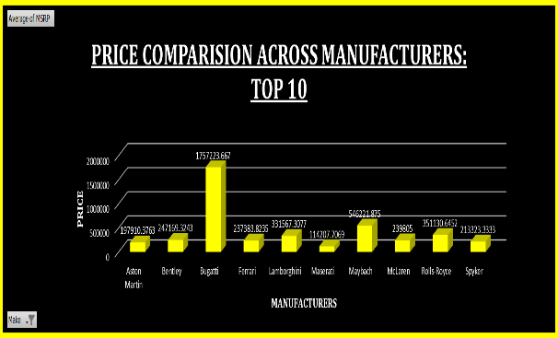
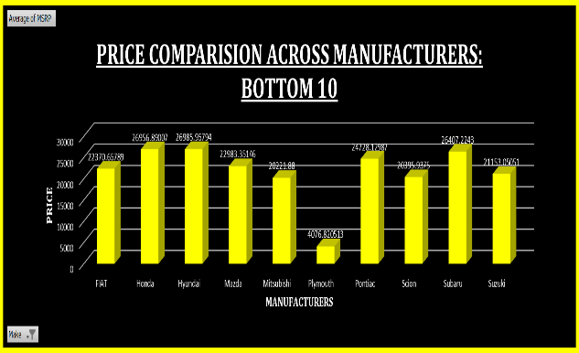

A_Task- 4: How does the average price of a car vary across different manufacturers?

Slide 19


“Bugatti”, “Maybach”, and “Rolls Royce” are the manufacturers with the highest average prices for cars.
“Bugatti” has the highest average price range, while “Plymouth” has the lowest average price range among the manufacturers.

Slide 20
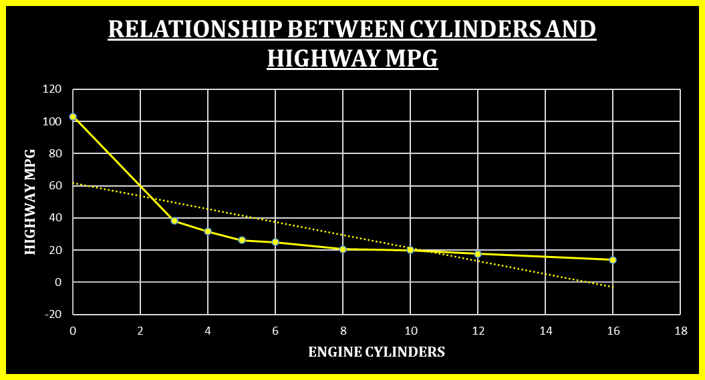

A_Task- 5: What is the relationship between fuel efficiency and the number of cylinders in a car’s engine?

Slide 21

A_Task- 5: What is the relationship between fuel efficiency and the number of cylinders in a car’s engine?
There is an inverse relationship between the number of engine cylinders and the average highway MPG.
Cars with fewer engine cylinders tend to have higher average highway MPG, while cars with more engine cylinders have lower average highway MPG.

Slide 22
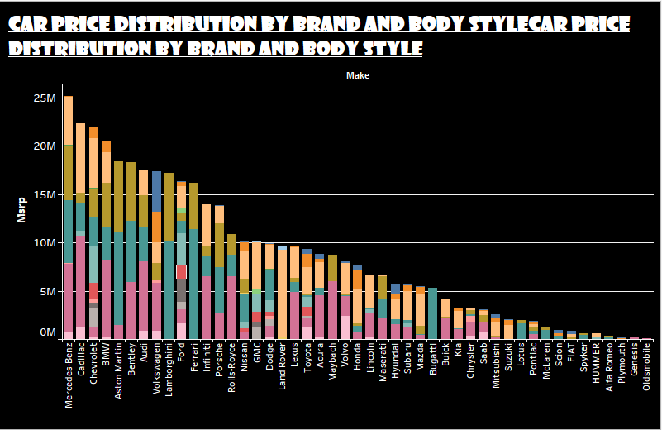
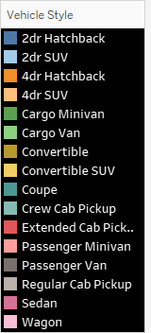

D_Task- 1: How does the distribution of car prices vary by brand and body style?

Slide 23
D_Task- 1: How does the distribution of car prices vary by brand and body style?
The distribution of car prices varies by brand and body style. Different brands and body styles have different price ranges.
For example, “Genesis” only manufactures “Sedans” with an average MSRP of $1,39,850, while “Chevrolet” offers various body styles, with “Sedans” having a total MSRP of $8,80,480.

Slide 24
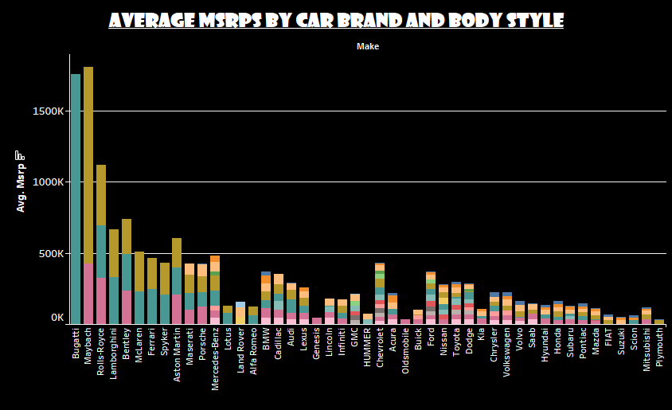

D_Task- 2: Which car brands have the highest and lowest average MSRPs, and how does this vary by body style?

Slide 25

D_Task- 2: Which car brands have the highest and lowest average MSRPs, and how does this vary by body style?
“Bugatti” has the highest average MSRP, mainly due to its “Coupe” body style. “Maybach” follows closely with two body styles: “Sedan” and “Convertible”.
“Plymouth” and “Oldsmobile” have the lowest average MSRP among the manufacturers, despite offering multiple body styles.

Slide 26
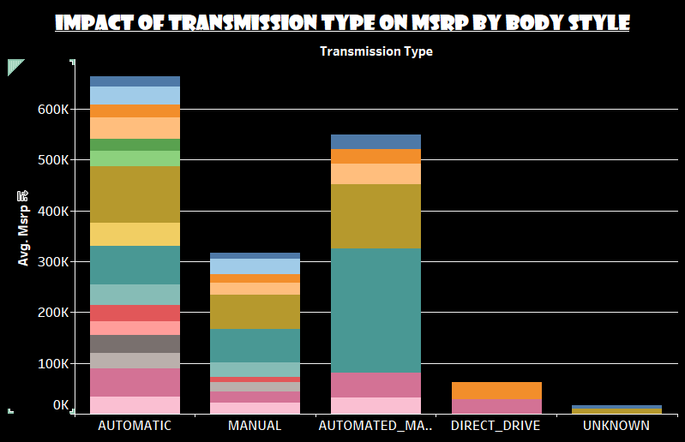

D_Task- 3: How do the different features such as transmission type affect the MSRP, and how does this vary by body style?

Slide 27

D_Task- 3: How do the different features such as transmission type affect the MSRP, and how does this vary by body style?
The choice of transmission type also affects the average MSRP, especially when considering different body styles.
For example, “Coupes” with an “automated manual” transmission type has the highest average MSRP, while “Convertibles” with “automatic” transmission has a relatively lower average MSRP.

Slide 28
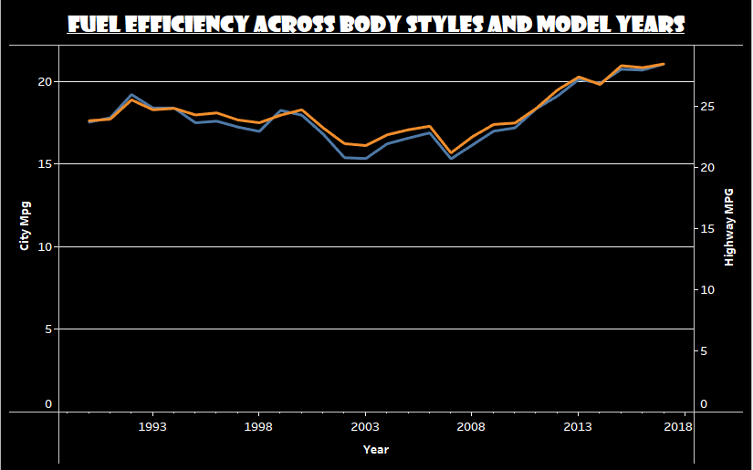


D_Task- 4: How does the fuel efficiency of cars vary across different body styles and model years?

Slide 29

D_Task- 4: How does the fuel efficiency of cars vary across different body styles and model years?
Fuel efficiency, measured by city MPG and highway MPG, varies across different body styles and model years.
There are fluctuations in fuel efficiency over the years, but overall, there is a trend of improvement in city and highway MPG.

Slide 30
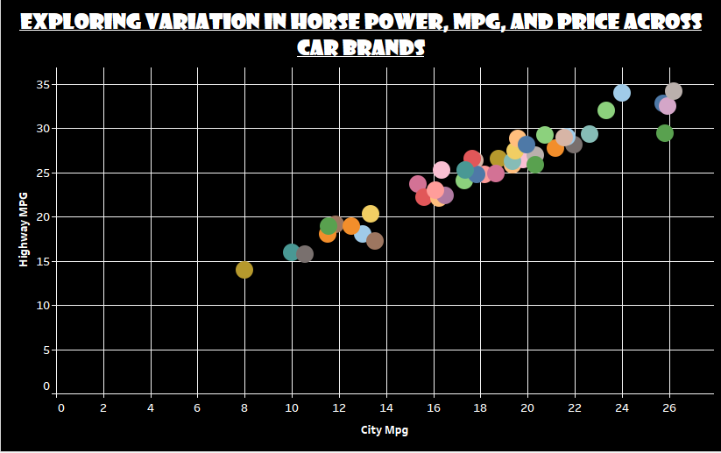
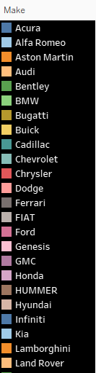

D_Task- 5: How does the car's horsepower, MPG, and price vary across different Brands?

Slide 31

D_Task- 5: How does the car's horsepower, MPG, and price vary across different Brands?
Different car brands offer varying levels of engine horsepower, city MPG, highway MPG, and price.
For instance, “BMW” provides a balance between engine horsepower (326.9), city MPG (20.74), highway MPG (29.25), and an average price of $61,547. On the other hand, “Bugatti” offers high horsepower (1001), low MPG, and a significantly higher average price of $17,57,223.

Slide 32
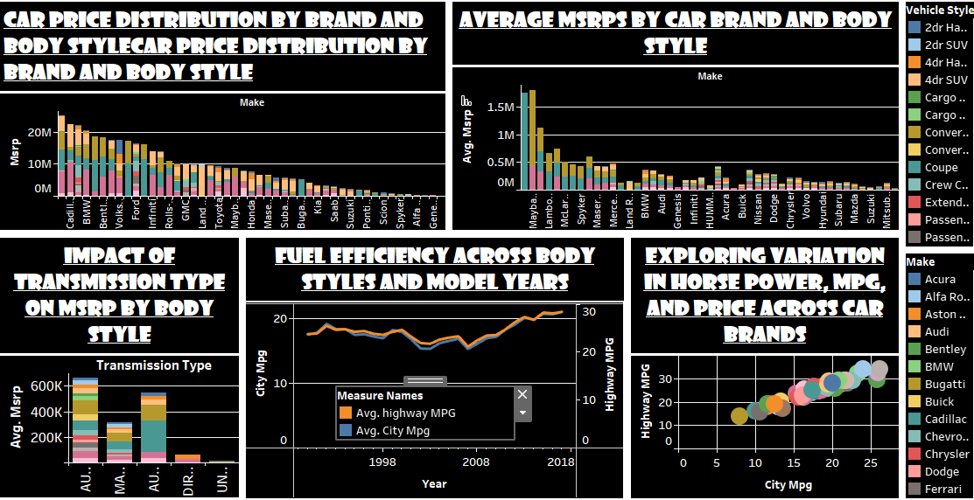
DASHBOARD

Slide 33

CONCLUSION
The analysis of the car's dataset revealed several important insights regarding car prices, market categories, car features, and fuel efficiency. The following key conclusions can be drawn from the findings:
Car prices vary significantly by brand and body style. Some brands, such as Bugatti, Maybach, and Rolls Royce, have higher average MSRPs compared to others. The choice of body style also influences the price range of cars, with certain body styles commanding higher prices.
Engine power, measured in horsepower (HP), plays a crucial role in determining car prices. Cars with higher horsepower tend to have higher average costs. This indicates that customers are willing to pay more for increased engine performance.
The analysis highlights the relative importance of car features on price. Engine cylinder count, MPG (both city and highway), engine HP, vehicle style, and fuel type all contribute to the pricing of cars. Understanding these factors is vital for car manufacturers to set competitive prices and meet customer demands.
The analysis also reveals differences in fuel efficiency across body styles and model years. While there have been improvements in overall fuel efficiency, variations exist among different body styles and over time. This information can guide car buyers in choosing more fuel-efficient options.

Slide 34

DRIVE LINK
Link for Excel File:
C:\Users\admin\Desktop\Analyzing of impact car features on price and profitability.xlsx
Link for Tableau public page:
https://public.tableau.com/app/profile/alankrita.paul/viz/Trainityproject7/Sheet1

Slide 35
THANK YOU!

